Slide 1

Usability
Computer Science @ JTHS
Notes:
Matrix soundtrack +progress presents boy wonder …….. Best songs

Slide 2
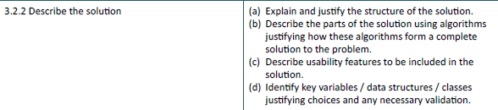
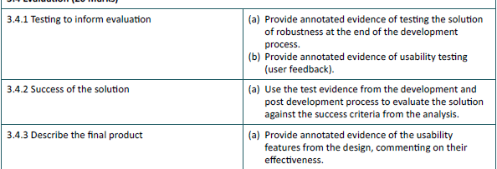

Slide 3
What is usability
A qualitative attribute that measures how easy a program or website is to use.
Split into 5 key areas :
Learnability: How easy is it for users to accomplish basic tasks the first time they encounter the design?
Efficiency: Once users have learned the design, how quickly can they perform tasks?
Memorability: When users return to the design after a period of not using it, how easily can they re-establish proficiency?
Errors: How many errors do users make, how severe are these errors, and how easily can they recover from the errors?
Satisfaction: How pleasant is it to use the design?

Slide 4
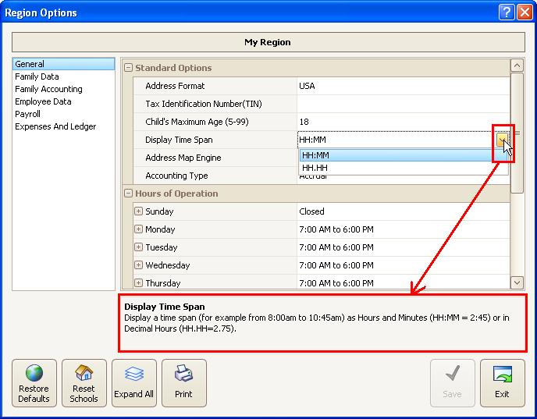
Instructions and help
Provide instructions for the user at every point.

Slide 5
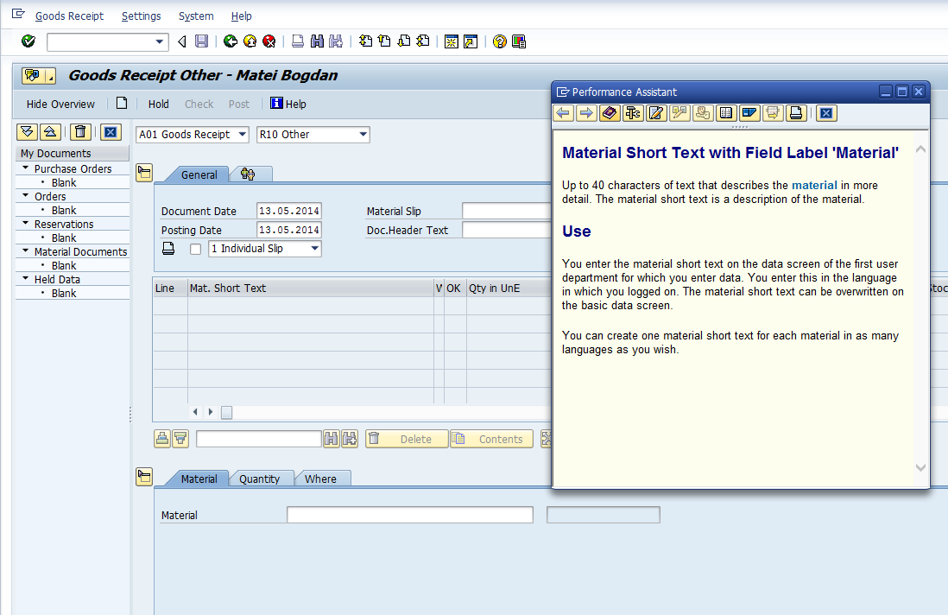
Instructions and help
If necessary, provide an entire help section that is accessible from screen.

Slide 6
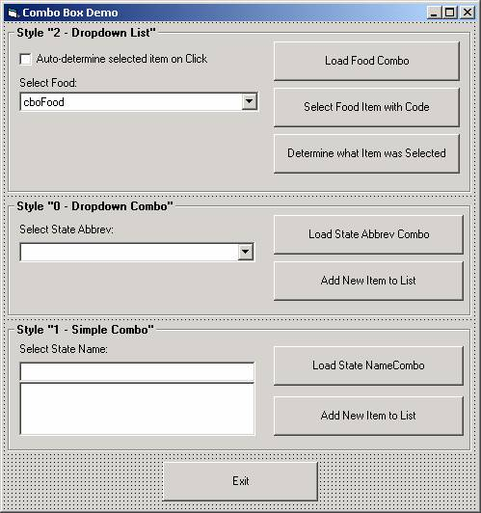
Input type
Provide the most suitable type of input method available.
Don’t ask users to type in a value if they could easily select it from a list of a drop down box!

Slide 7
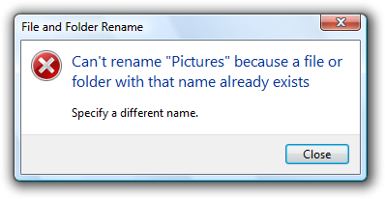
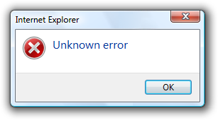
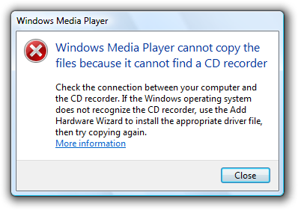
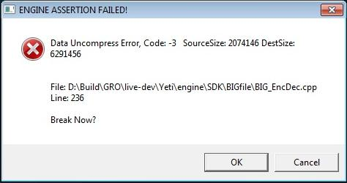
Errors
Anticipate and trap errors.
Make sure that error messages are friendly, non-technical and explain the problem.
Ideally, they should also explain what to do to resolve the problem.

Slide 8
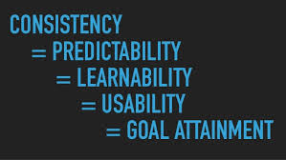
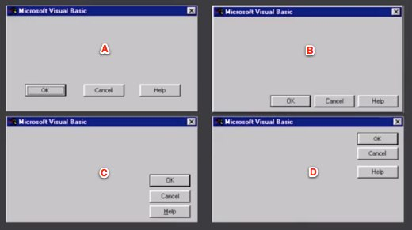
Consistency
All sections of your program should look and act in the same way.
This could be as simple as a colour scheme and logo.
It also applies to where features appear on the page. Make this consistent between sections!

Slide 9
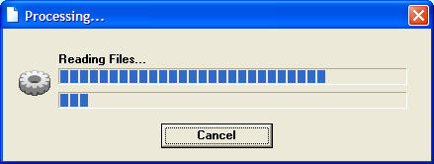
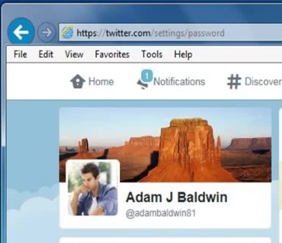
System status
Make sure that the user is aware of what the program is doing.
Is it logged in? Logged out? Waiting for input?
If logged in, can this be shown or personalised?

Slide 10
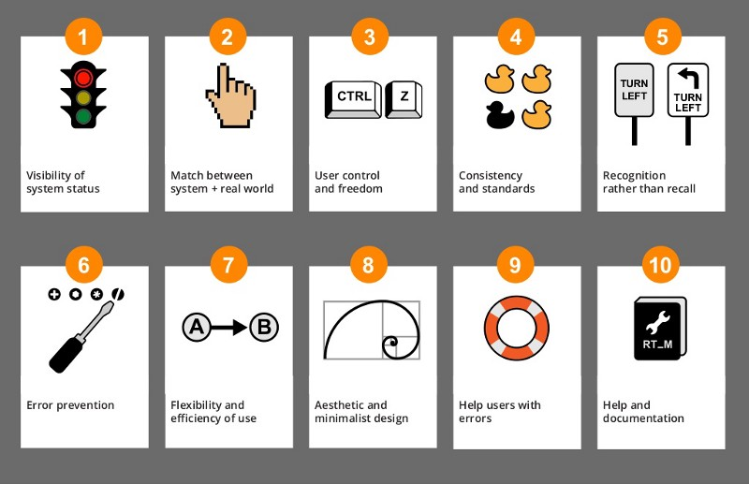
Other usability measures

Slide 11
Summary
Your project will have good usability features if…
Users can complete all of their actions without needing to refer to a user manual or ask someone for support.
On screen guidance is provided for when users do need a bit of help.
If errors are anticipated and minimised (validated), with appropriate helpful error messages when errors do occur.
Users have a consistent experience, with the same “look and feel” on every page / section of your program.
Users are told what is happening at each point.

Slide 12
How to demonstrate this (high marks)
Refer to usability in your designs.
Refer to usability in your implementation work.
Justify all of your choices and explain how they will improve usability features.
Test specifically for usability, involving test users and asking them to do things that you have not told them how to do. Ask them for scores based on how comfortable they feel using the system.
When the project is finished, specifically highlight (screenshot / explain) the usability features you have included “to show them off” to the moderator.

Slide 13
Further reading
https://www.slideshare.net/crafted/10-usability-heuristics-explained
https://www.nngroup.com/articles/usability-101-introduction-to-usability/
http://www.experienceux.co.uk/faqs/what-is-usability-testing/
An expert on this topic is Jakob Nielsen. Although he tends to focus on web design rather than program design, the concepts are interchangeable. Google his name for much more information on good (and bad) usability examples, or follow him on Twitter.
http://www.designprinciplesftw.com/authors/jakob-nielsen

